Slide 1
Chapter 4 – Requirements Engineering

Slide 2
Topics covered
What is requirements
Types of requirements
Requirements engineering processes
The overall requirements engineering process includes four high-level requirements engineering sub-process
Requirements elicitation
Requirements analysis
Requirements validation
Requirements management

Slide 3
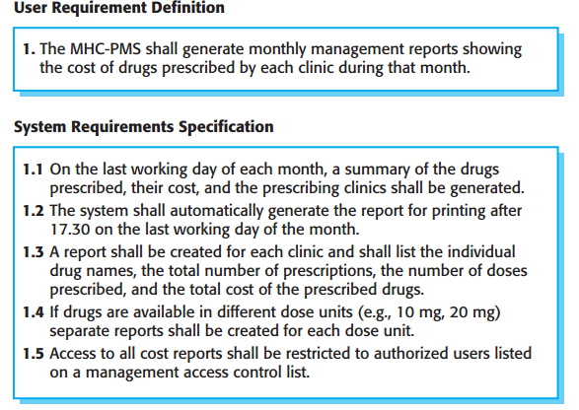

Slide 4
What is a requirements?
It may range from a high-level abstract statement of a service or of a system constraint to a detailed mathematical functional specification.
This is inevitable as requirements may serve a dual function
May be the basis for a bid for a contract – therefore must be open to interpretation;
May be the basis for the contract itself – therefore must be defined in detail;
Both these statements may be called requirements.

Slide 5
Functional and non-functional requirements
Functional requirements
Statements of services the system should provide, how the system should react to particular inputs and how the system should behave in particular situations.
May state what the system should not do.
Non-functional requirements
Constraints on the services or functions offered by the system such as timing constraints, constraints on the development process, standards, etc.
Often apply to the system as a whole rather than individual features or services.

Slide 6
Functional requirements
Describe functionality or system services.
Depend on the type of software, expected users and the type of system where the software is used.
Functional user requirements may be high-level statements of what the system should do.
Functional system requirements should describe the system services in detail.

Slide 7
Non-functional requirements
These define system properties and constraints e.g. reliability, response time and storage requirements. Constraints are I/O device capability, system representations, etc.
Process requirements may also be specified mandating a particular IDE, programming language or development method.
Non-functional requirements may be more critical than functional requirements. If these are not met, the system may be useless.

Slide 8
Non-functional classifications
Product requirements
Requirements which specify that the delivered product must behave in a particular way e.g. execution speed, reliability, etc.
Organisational requirements
Requirements which are a consequence of organisational policies and procedures e.g. process standards used, implementation requirements, etc. (meeting budget limitations, company guidelines on data handling)
External requirements
Requirements which arise from factors which are external to the system and its development process e.g. interoperability requirements, legislative requirements, etc.

Slide 9
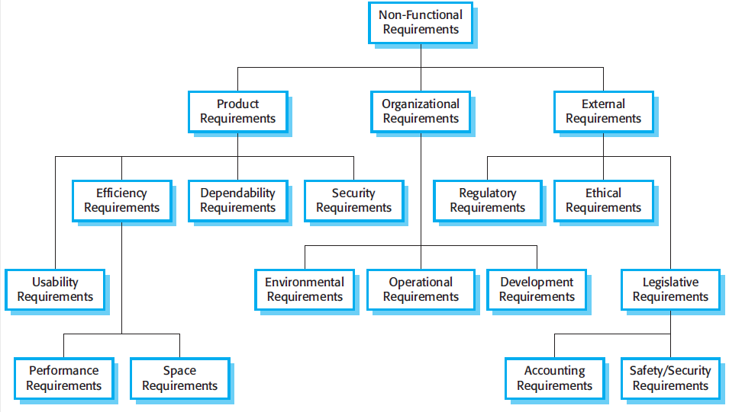

Slide 10
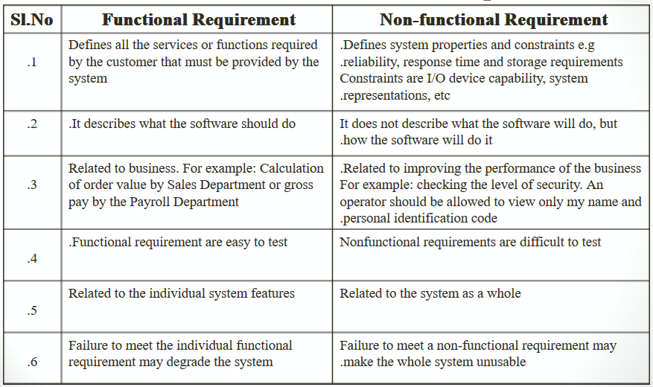

Slide 11
Examples of nonfunctional requirements in the MHC-PMS
Functional requirement 1. A user shall be able to search the appointments lists for all clinics. 2. The system shall generate each day, for each clinic, a list of patients who are expected to attend appointments that day. 3. Each staff member using the system shall be uniquely identified by his or her eight-digit employee number. Product requirement The MHC-PMS shall be available to all clinics during normal working hours (Mon–Fri, 0830–17.30). Downtime within normal working hours shall not exceed five seconds in any one day. Organizational requirement Users of the MHC-PMS system shall authenticate themselves using their health authority identity card. External requirement The system shall implement patient privacy provisions as set out in HStan-03-2006-priv.

Slide 12
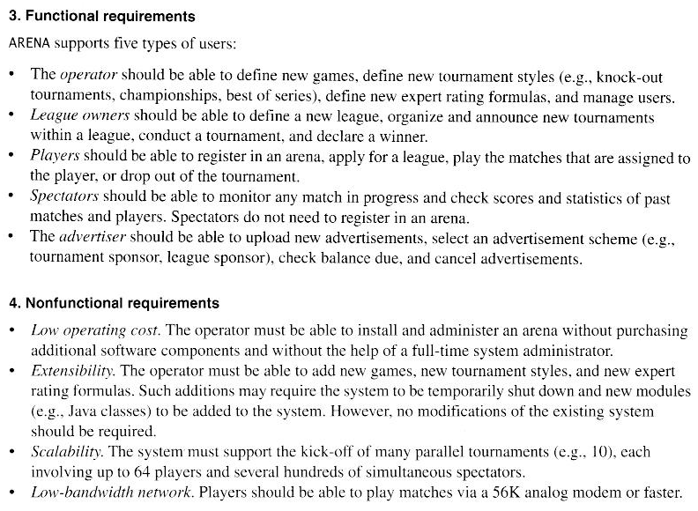

Slide 13
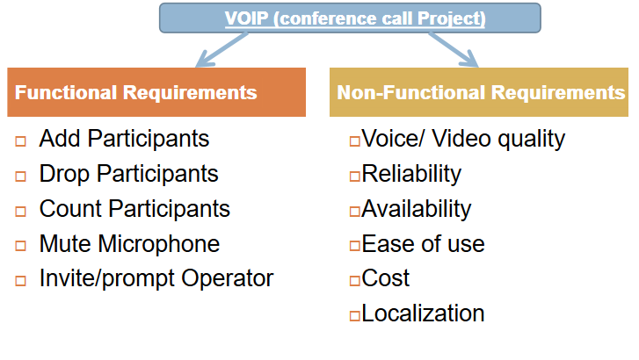

Slide 14
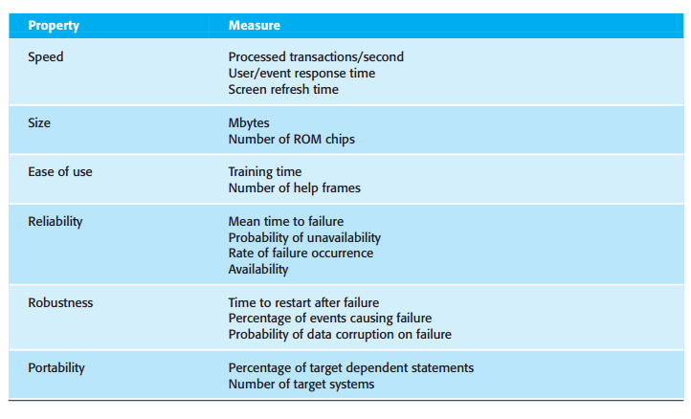
Metrics for specifying non-functional requirements

Slide 15
Requirements engineering processes
The processes used for RE vary widely depending on the application domain, the people involved and the organisation developing the requirements.
However, there are a number of generic activities common to all processes
Requirements elicitation;
Requirements analysis;
Requirements validation;
Requirements management.

Slide 16
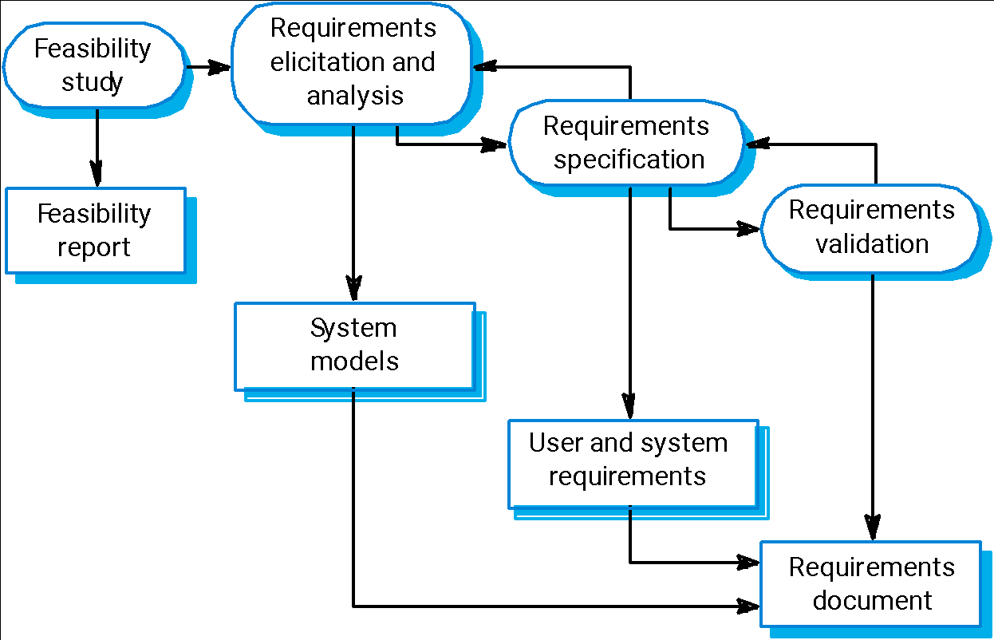
The requirements engineering process

Slide 17
Feasibility studies
A feasibility study decides whether or not the proposed system is worthwhile.
A short focused study that checks
If the system contributes to organisational objectives;
If the system can be engineered using current technology and within budget;
If the system can be integrated with other systems that are already used.

Slide 18
Feasibility study implementation
Based on information assessment (what is required), information collection and report writing.
Questions for people in the organisation
What if the system wasn’t implemented?
What are current process problems?
How will the proposed system help?
What will be the integration problems?
Is new technology needed? What skills?
What facilities must be supported by the proposed system?

Slide 19
Elicitation and analysis
Sometimes called requirements elicitation or requirements discovery.
Involves technical staff working with customers to find out about the application domain, the services that the system should provide and the system’s operational constraints.
May involve end-users, managers, engineers involved in maintenance, domain experts, trade unions, etc. These are called stakeholders.

Slide 20
Problems of requirements analysis
Stakeholders don’t know what they really want.
Stakeholders express requirements in their own terms.
Different stakeholders may have conflicting requirements.
Organisational and political factors may influence the system requirements.
The requirements change during the analysis process. New stakeholders may emerge and the business environment change.

Slide 21
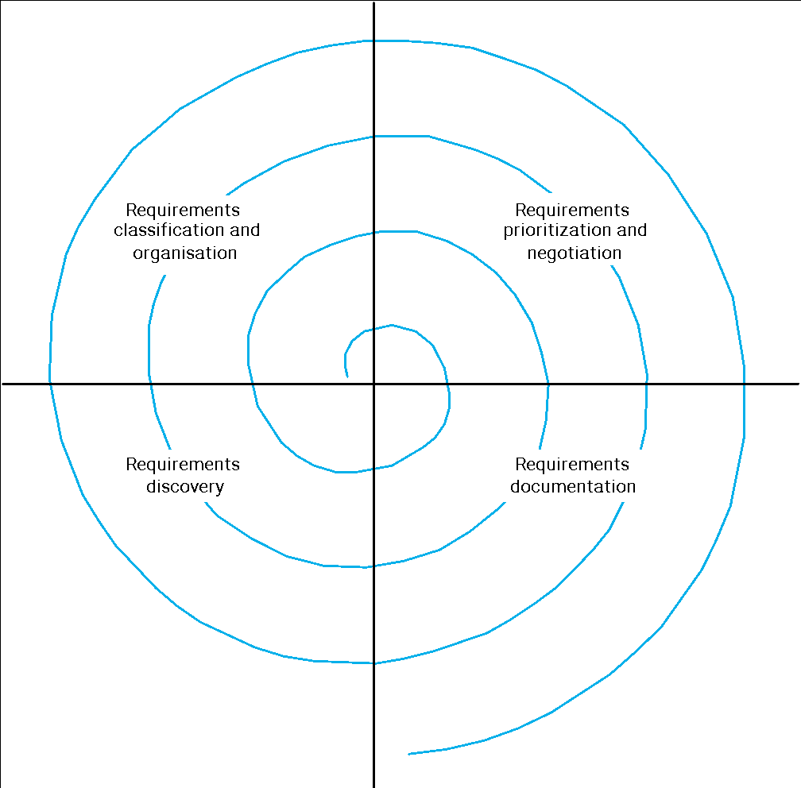
The requirements spiral for elicitation and analysis process
This iterative process starts from requirements discovery and ends with requirements documentation.

Slide 22
Process activities
Requirements discovery
Interacting with stakeholders to discover their requirements. Domain requirements are also discovered at this stage.
Requirements classification and organisation
Groups related requirements and organises them into coherent clusters.
For example, it is possible to use model of the system architecture to identify subsystem and grouping related requirements.
Prioritisation and negotiation
Prioritising requirements and resolving requirements conflicts.
For example it is possible to organize stakeholders negotiations so that compromises can be reached.
Requirements documentation
Requirements are documented and input into the next round of the spiral. The documentation can be formal or informal.
For example, extreme programming uses formal documents and cards and it is very easy for stakeholders to handle, change and organise requirements.

Slide 23
Requirements discovery
The process of gathering information about the proposed and existing systems and distilling the user and system requirements from this information.
Sources of information include documentation, system stakeholders and the specifications of similar systems.
http://www.navodayaengg.in/wp-content/uploads/2015/10/Lect6_Requirements-Discovery.pdf

Slide 24
Requirements discovery and viewpoints
Viewpoints are a way of structuring the requirements to represent the perspectives of different stakeholders. Stakeholders and other sources may be classified under different viewpoints.
This multi-perspective analysis is important as there is no single correct way to analyse system requirements.
Types of viewpoint
Interactor viewpoints (customers and account database)
Indirect viewpoints (management and security staff.)
Domain viewpoints (standards that have been developed for interbank communications)
Notes:
Interactor viewpoints represent people or other systems that interact directly with the system. In the bank ATM system, examples of interactor viewpoints are the bank’s customers and the bank’s account database.
Indirect viewpoints represent stakeholders who do not use the system themselves but who influence the requirements in some way. In the bank ATM system, examples of indirect viewpoints are the management of the bank and the bank security staff.
Domain viewpoints represent domain characteristics and constraints that influence the system requirements. In the bank ATM system, an example of a domain viewpoint would be the standards that have been developed for interbank communications.

Slide 25
Requirements discovery and interviewing
In formal or informal interviewing, the RE team puts questions to stakeholders about the system that they use and the system to be developed.
There are two types of interview
Closed interviews where a pre-defined set of questions are answered.
Open interviews where there is no pre-defined agenda and a range of issues are explored with stakeholders.

Slide 26
Interviews in practice
Normally a mix of closed and open-ended interviewing.
Interviews are good for getting an overall understanding of what stakeholders do and how they might interact with the system.
Interviews are not good for understanding domain requirements for two reasons:
Requirements engineers cannot understand specific domain terminology;
Some domain knowledge is so familiar that people find it hard to articulate or think that it isn’t worth articulating.

Slide 27
Requirements discovery and scenarios (1/2)
People usually find it easier to relate to real-life examples than to abstract description.
They can understand and critique a scenario of how they can interact with the system.
That is, scenario can be particularly useful for adding detail to an outline requirements description:
they are description of example interaction sessions;
each scenario covers one or more possible interaction;
Several forms of scenarios have been developed, each of which provides different types of information at different level of detail about the system.

Slide 28
Requirements discovery and scenarios (2/2)
Scenarios are real-life examples of how a system can be used.
They should include
A description of the starting situation;
A description of the normal flow of events;
A description of what can go wrong;
Information about other concurrent activities;
A description of the state when the scenario finishes.
Scenarios described as text might be supplemented by some kind of diagrams, screen-shot and so on.
Alternatively, a more structured approach such as event scenarios and/or use-case may be adopted.

Slide 29
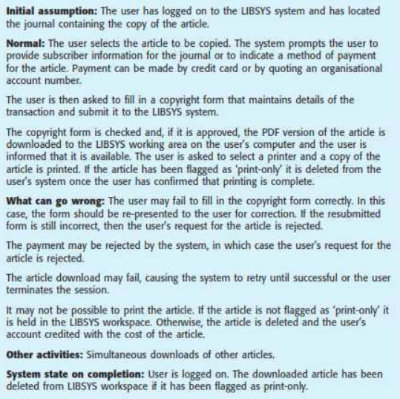

Slide 30
Use-cases and scenarios (1/2)
Scenarios and use-cases are effective technique for eliciting requirements for interactor viewpoints. In fact each interaction can be represented as a use-case supplemented by scenarios.
They may also be used for indirect viewpoint when these viewpoint receive some result. For example consider the Library Manager of our example.

Slide 31
Use-cases and scenarios (2/2)
Due to their “low-level nature” in this context (requirements engineering process), scenarios and use-cases are not so effective
for discovering constraints and/or high-level non-functional requirements;
for discovering domain requirements.

Slide 32
Requirements validation
Concerned with demonstrating that the requirements define the system that the customer really wants.
Requirements validation covers a part of analysis in that it is concerned with finding problems with requirements.
Requirements error costs are high so validation is very important
Fixing a requirements error after delivery may cost up to 100 times the cost of fixing an implementation error.
In fact, a change to the requirements usually means that the system design and the implementation must also be changed and the testing has to be performed again.

Slide 33
Checks required during the requirements validation process
Validity checks. Does the system provide the functions which best support the customer’s needs? ( Other functions maybe identified by a further analysis )
Consistency checks. Are there any requirements conflicts?
Completeness checks. Are all the requirements needed to define all functions required by the customer sufficiently specified?
Realism checks. Can the requirements be implemented given available budget, technology and schedule?
Verifiability. Can the requirements be checked?

Slide 34
Requirements validation techniques
The following techniques can be used individually or in conjunction.
Requirements reviews
Systematic manual analysis of the requirements performed by a team of reviewers.
Prototyping
Using an executable model of the system to check requirements.
Test-case generation
Developing tests for requirements to check testability.
If the test is difficult to design, usually the related requirements are difficult to implement.

Slide 35
Requirements management
The requirements for large systems are frequently changing.
In fact, during the software process, the stakeholders’ understanding of the problem is constantly changing.
Requirements management is the process of managing changing requirements during the requirements engineering process and system development.
Requirements are inevitably incomplete and inconsistent
New requirements emerge during the process as business needs change and a better understanding of the system is developed;
Different viewpoints have different requirements and these are often contradictory.

Slide 36
Requirements management
It is hard for the users and customers to anticipate what effects the new system will have on the organization.
Often, only when the system has been deployed, new requirements inevitably emerge.
This is mainly due to the fact that, when the end-users have experience of the new system, they discover new needs and priority.

Slide 37
Requirements change
The priority of requirements from different viewpoints changes during the development process. Conflicts have to inevitably converge in a compromise.
System customers may specify requirements from a business perspective that conflict with end-user requirements.
The business and technical environment of the system changes during its development.
New hardware, new interface, business priority, new regulations, etc.

Slide 38
Requirement changes and the requirements management
The requirements management is the process of identifying, understanding and controlling changes to system requirements.
It might be useful to keep track of individual requirements and maintain links between dependent requirements so that you can asset the impact of requirements changes.
The process of requirements management should start as soon as a draft a version of the requirement document is available.

Slide 39
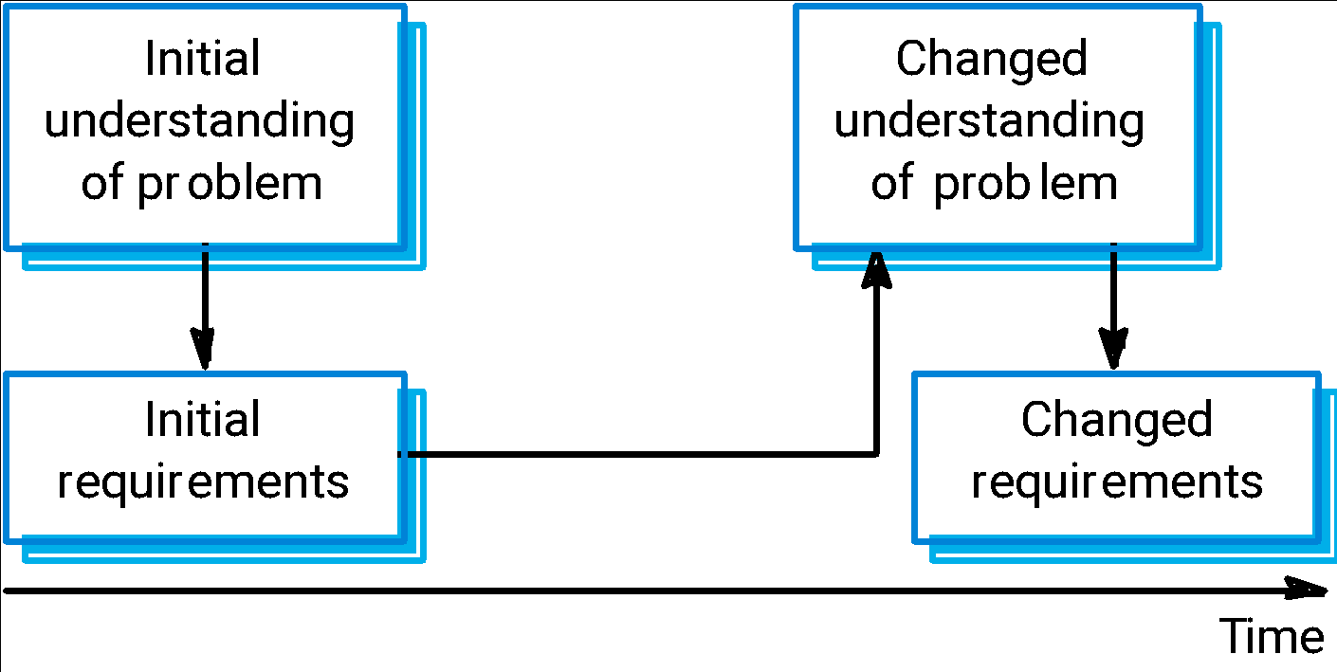
Requirements evolution

Slide 40
Enduring and volatile requirements
From an evolution perspective, requirements fall into two classes:
Enduring requirements. Stable requirements derived from the core activity of the customer organisation and relate directly to the domain of the system.
E.g., In a hospital, requirements will always relate to doctors, nurses, etc.
These requirements may be derived from a domain conceptual models that show entities and relations between them.
Volatile requirements. Requirements which change during development or when the system is in use.
E.g., In a hospital, requirements derived from healthcare policy;

Slide 41
Requirements management planning
Since the RE process is very expensive, it might be useful to establish a planning.
In fact, during the requirements engineering process, you have to plan:
Requirements identification
How requirements are individually identified; they should be uniquely identified in order to keep a better traceability.
A change management process
The process followed when requirements change: the set of activities that estimate the impact and cost of changes.
Traceability policies
The policy for managing the amount of information about relationships between requirements and between system design and requirements that should be maintained (e.g., in a Data Base)
CASE tool support
The tool support required to help manage requirements change; tolls can range from specialist requirements management systems to simple data base systems.

Slide 42
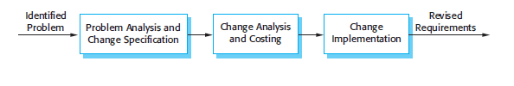
Change Management Phases
Problem analysis and change specification
Change analysis and costing
Change implementation

Slide 43
Key points
The requirements engineering process includes a feasibility study, requirements elicitation and analysis, requirements specification and requirements management.
Requirements elicitation and analysis is iterative involving domain understanding, requirements collection, classification, structuring, prioritisation and validation.
Systems have multiple stakeholders with different requirements.
Business changes inevitably lead to changing requirements.
Requirements management includes planning and change management.
Requirements validation is concerned with checks for validity, consistency, completeness, realism and verifiability.

